Slide 1
Players Titles
Calculating Norms

Slide 2
FIDE Titles for Players
FIDE offers the following titles:
Grandmaster (GM) Woman Grandmaster (WGM)
International Master (IM) Woman International Master (WIM)
FIDE Master (FM) Woman FIDE Master (WFM)
Candidate Master (CM) Woman Candidate Master (WCM)
The (W)GM and (W)IM titles are won by achieving norms in events. The (W)FM and (W)CM titles are normally won by achieving a rating of a certain level but can also be awarded in certain tournaments
GM performance is ≥ 2600 performance against opponents with average rating ≥ 2380. IM performance is ≥ 2450 performance against opponents with average rating ≥ 2230. WGM performance is ≥ 2400 performance against opponents with average rating ≥ 2180. WIM performance is ≥ 2250 performance against opponents with average rating ≥ 2030.
FM ≥ 2300, CM ≥ 2200, WFM ≥ 2100, WCM ≥ 2000 at any time even if not published.

Slide 3
Various International Championship tournaments can award titles and/or norms.
However the most common way of getting norms is by performance in tournaments.
Conditions other than rating performance that must be met:
No more than 2 rounds per day
No more than 12 hours play a day (based on 60 moves if increments used)
Without increments the minimum time is 2 hours for 40 moves with an additional 30 minutes to complete the game
With increments the minimum time is 90 minutes with 30 second increments from the beginning.
The arbiter must be at least an FA and licenced
No arbiter for the event can play in it even as a filler.

Slide 4
Title Norms
The following are excluded
Games decided by forfeit, adjudication or by any other means than over the board play
In round robins games against unrated players who score 0

Slide 5
Title norm conditions for normal event
Minimum 9 games (8+a bye or default)
Minimum 50% title holders (excluding CM or WCM)
Minimum of 1/3 (one third) must be title holders of sought status or above
Maximum of unrated opponents is 20%
Maximum of 2/3 (two thirds) of opponents from one federation
Maximum of 60% from norm seekers federation
Minimum of 2 federations other than norm seekers own
Games | ≥9
Title Holders | ≥50%
Title sought | ≥33.3%
Unrated | ≤20%
Opp from 1 fed | ≤66.7%
Opp from own fed | ≤60%
Other Feds≥≤ | ≥2

Slide 6
Exceptions to the normal conditions
International Championships (eg Continental, Olympiad)
The following are exempt from federation requirements
National Men’s, Women’s or Open Championships (host nation only)
National Team Championships (host nation only)
Zonal and Sub zonal tournaments
Swiss system events with minimum 20 FIDE rated players from at least 3 federations different from the host and at least 10 of whom are GM, IM, WGM or WIM.
At least one norm must be obtained under normal foreigner requirements

Slide 7
Performance Rating
Title | Minimum Performance | Min Average Rating of Opponents
GM | 2599.5 | 2380
IM | 2449.5 | 2230
WGM | 2399.5 | 2180
WIM | 2249.5 | 2030
The rating performance is Average rating of opponents (adjusted) + rating difference (d_{p}) from table

Slide 8
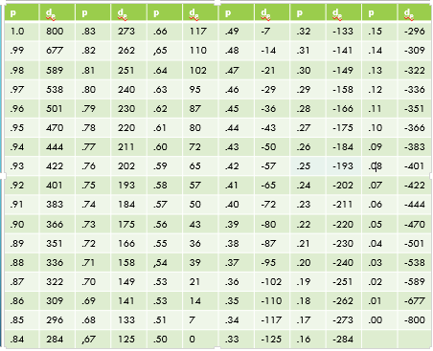
Norm Calculation
Has the following Czech Republic player achieved a GM norm?
Average 2422.78 Score 7.
Games 9 ✓
Title holders 7 ✓
Unrated 0 ✓
Opponents from 1 fed =max 2 ✓
Opp from own federation = 2 ✓
Other federations = 5 ✓
OpponentRating | Nat | Title | Score
2238 | CZE |  | 1
2462 | IND | IM | 1
2552 | ITA | GM | 1
2200 | CZE |  | 1
2502 | ITA | GM | 0.5
2314 | POL | WGM | 0
2448 | RUS | GM | 0.5
2597 | EGY | GM | 1
2492 | IND | GM | 1
Games | ≥9
Title Holders | ≥50%
Title sought | ≥33.3%
Unrated | ≤20%
Opp from 1 fed | ≤66.7%
Opp from own fed | ≤60%
Other Feds≥≤ | ≥2
Performance= 7/9 = 0.78
From table this gives 220
2422.78+220= 2643
So GM norm achieved.

Slide 9
Norm Calculation
Has the following Czech Republic player achieved a GM norm?
Average 2422.78 Score 6.5.
Games 9 ✓
Title holders 7 ✓
Unrated 0 ✓
Opponents from 1 fed =max 2 ✓
Opp from own federation = 2 ✓
Other federations = 5 ✓
OpponentRating | Nat | Title | Score
2238 | CZE |  | 1
2462 | IND | IM | 1
2552 | ITA | GM | 1
2220 | CZE |  | 1
2502 | ITA | GM | 0.5
2314 | POL | WGM | 0
2448 | RUS | GM | 0.5
2597 | EGY | GM | 1
2492 | IND | GM | 0.5
29
Games | ≥9
Title Holders | ≥50%
Title sought | ≥33.3%
Unrated | ≤20%
Opp from 1 fed | ≤66.7%
Opp from own fed | ≤60%
Other Feds≥≤ | ≥2
Performance= 6.5/9 = 0.722
From table this gives 166
2422.78+166= 2589
So GM norm NOT achieved.

Slide 10
Norm Calculation
Has the following Czech Republic player achieved a GM norm?
Here the average is 2378.33
OpponentRating | Nat | Title | Score
2238 | CZE |  | 1
2462 | IND | IM | 1
2552 | ITA | GM | 1
1800 | CZE |  | 1
2502 | ITA | GM | 0.5
2314 | POL | WGM | 0
2448 | RUS | GM | 0.5
2597 | EGY | GM | 1
2492 | IND | GM | 1
Performance= 7/9 = 0.78
From table this gives 220
2378.33+220= 2598
So GM norm apparently not achieved.
However player 4 is below the GM floor of 2200 so can be raised to that.
When he is the norm is achieved.
Games | ≥9
Title Holders | ≥50%
Title sought | ≥33.3%
Unrated | ≤20%
Opp from 1 fed | ≤66.7%
Opp from own fed | ≤60%
Other Feds≥≤ | ≥2

Slide 11
Norm calculation
This Czech Republic player is seeking an IM norm.
Games = 11
Score = 7
Average = 2432.5
TPR = 2432.5 + 102
= 2535
Unfortunately the number
of CZE opponents is 63.6%
Can anything be done?
We can discard wins.
Look for the lowest rated CZE player
that can be eliminated. Round 4 was
lowest rated but was not a win.
Therefore eliminate round 1.
New average = 2463.2 Score = 6/10 (.6)
TPR = 2463.2 + 72 = 2535.2
Note that if one opponent had been rated 3 points more even scoring 0.5 less would allow an IM norm to be achieved.
 | Rating | Nat | Title | Score
1 | 2238 | CZE |  | 1
2 | 2462 | CZE | IM | 1
3 | 2552 | ITA | GM | 1
4 | 2126 | CZE |  | 0.5
5 | 2502 | CZE | GM | 0.5
6 | 2314 | CZE | WGM | 0.5
7 | 2448 | CZE | GM | 0.5
8 | 2597 | EGY | GM | 0
9 | 2492 | ESP | GM | 0.5
10 | 2594 | ENG | GM | 0.5
11 | 2433 | CZE | IM | 1
Games | ≥9
Title Holders | ≥50%
Title sought | ≥33.3%
Unrated | ≤20%
Opp from 1 fed | ≤66.7%
Opp from own fed | ≤60%
Other Feds≥≤ | ≥2

Slide 12
Predicting Norms
9 rounds | GM | IM | WGM | WIM
Different MO | 3 GM | 3 IM | 3 WGM | 3 WIM
*Min. other feds. | 2 | 2 | 2 | 2
Rating floor for 1 player | 2200 | 2050 | 2000 | 1850
Different TH | 5 | 5 | 5 | 5
Max. number unrated | 2 | 2 | 2 | 2
*Max. from 1 fed. | 6 | 6 | 6 | 6
*Max. from own fed. | 5 | 5 | 5 | 5
7 | 2380-2433 | 2230-2283 | 2180-2233 | 2030-2083
6½ | 2434-2474 | 2284-2324 | 2234-2274 | 2084-2124
6 | 2475-2519 | 2325-2369 | 2275-2319 | 2125-2169
5½ | 2520-2556 | 2370-2406 | 2320-2356 | 2170-2206
5 | 2557-2599 | 2407-2449 | 2357-2399 | 2207-2249
4½ | 2600-2642 | 2450-2492 | 2400-2442 | 2250-2292
4 | 2643-2679 | 2493-2529 | 2443-2479 | 2293-2329
3½ | ≥2680 | ≥2530 | ≥2480 | ≥2330
This table (and similar for more rounds) can also be used in calculating norms.
The player is trying for a WIM
norm.
7 rounds have been played
and the round 8 draw has
been made.
What does the player need to
obtain the norm?
She has already scored 4.5.
The current average of opponents (inc rd 8) is 2086.875 (Total 16695).
For a norm scoring 6.5 the average must be 2083.5.
The player must therefore score 2pts and play a 2057 rated player in the last round.
For a norm scoring 6 the average must be 2124.5 so the last opponent must be rated 2426.

Slide 13
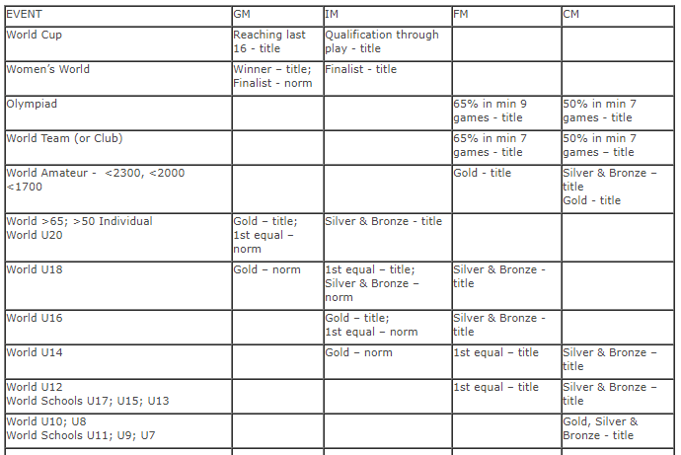
Direct Titles
FIDE gives a number of titles for performance in events.
These are given in tables 1.24a and 1.24b. Part of the latter is given opposite.

Slide 14
Form Filling
Three forms needed
IT1, IT2 and IT3 – also a crosstable.
IT2 is sent by Federation – everything else prepared by arbiter/organiser.

