Slide 1
Arbiters’ Seminar
Endorsed Pairing Programs

Slide 2
Approved Pairing Software
FIDE now has 8 approved programs for doing computer pairings.
Program | Pairing System | Pairing Engine
Vega | FIDE (Dutch) Dubov | JaVaFo Internal
SwissSys | FIDE (Dutch) | bbpPairings
SwissMaster | FIDE (Dutch) | JaVaFo
Swiss-Manager | FIDE (Dutch) | JaVaFo
Swiss-Chess | FIDE (Dutch) | Internal
UTU Swiss | FIDE (Dutch) | JaVaFo
ChessManager | FIDE (Dutch) | JaVaFo
STOP | FIDE (Dutch) | JaVaFo

Slide 3
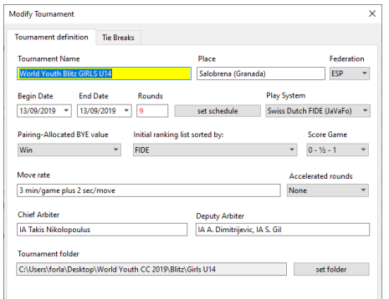
Vega
Comments:
User Friendly.
Only one to use Dubov.

Slide 4
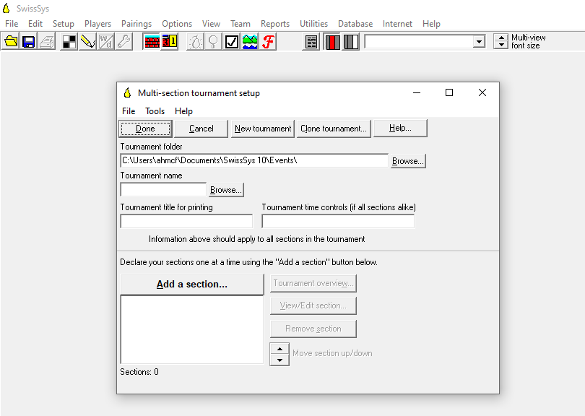
SwissSys
Comments:

Slide 5
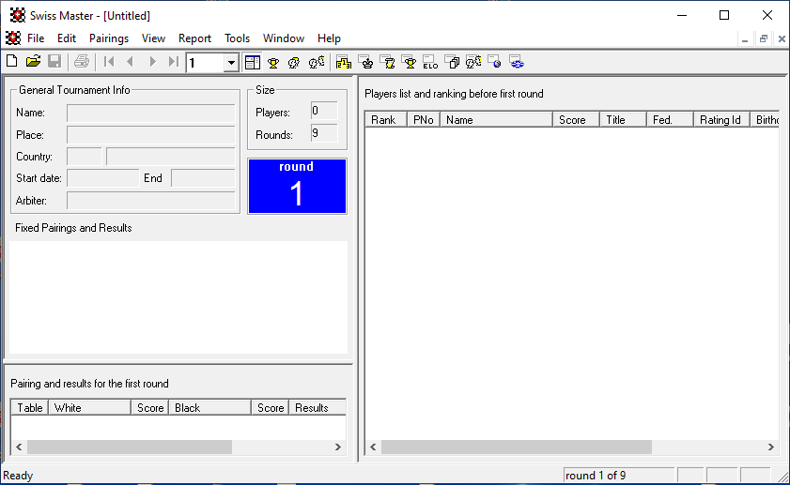
SwissMaster
Comments:
User Friendly
Limited to 300 players

Slide 6
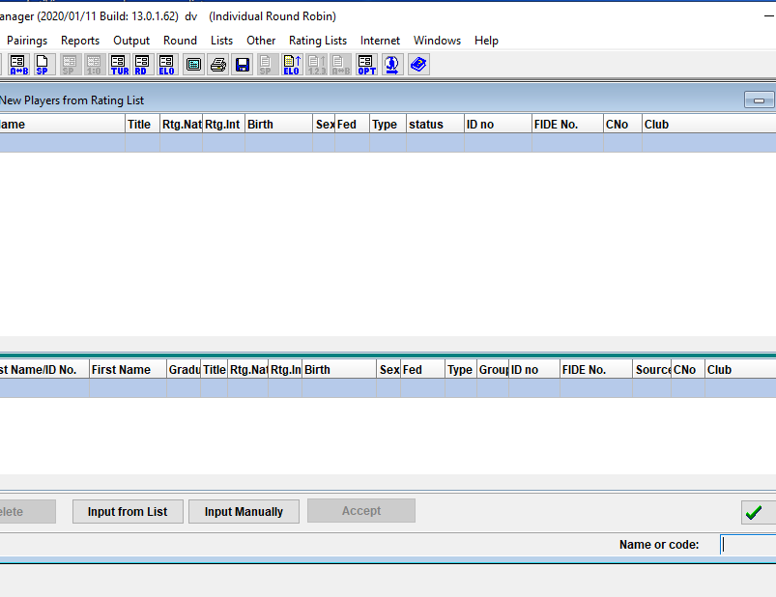
Swiss-Manager
Comments:
Menus not always easy to understand
Links directly to Chess-Results

Slide 7
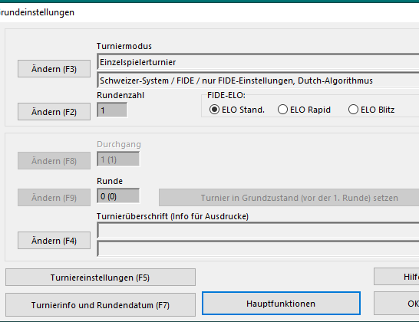
Swiss-Chess
Comments:
Links to Chess-Results

Slide 8
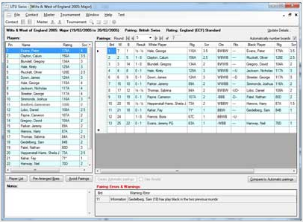
UTU Swiss
Comments:
User Friendly

Slide 9
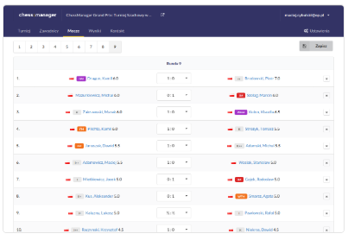
ChessManager
Comments:

Slide 10
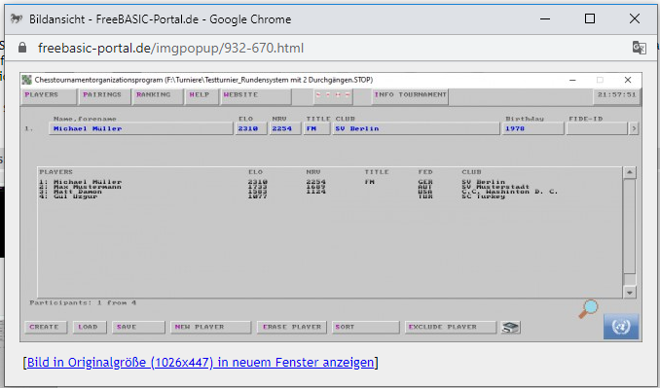
STOP
Comments:
80 player maximum

